Slide 1
Level Up
CS 147 - Designing for Healthy Behaviors
Low-fidelity Prototyping + Usability Testing

Slide 2
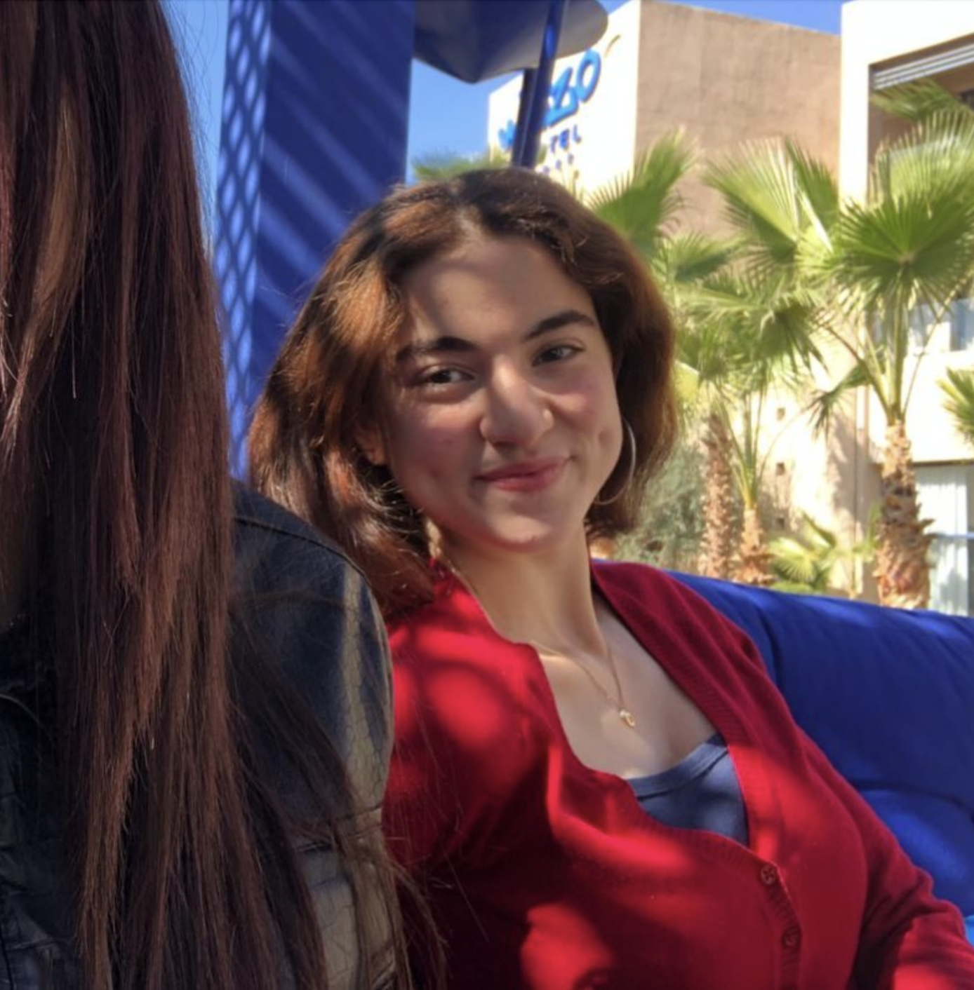
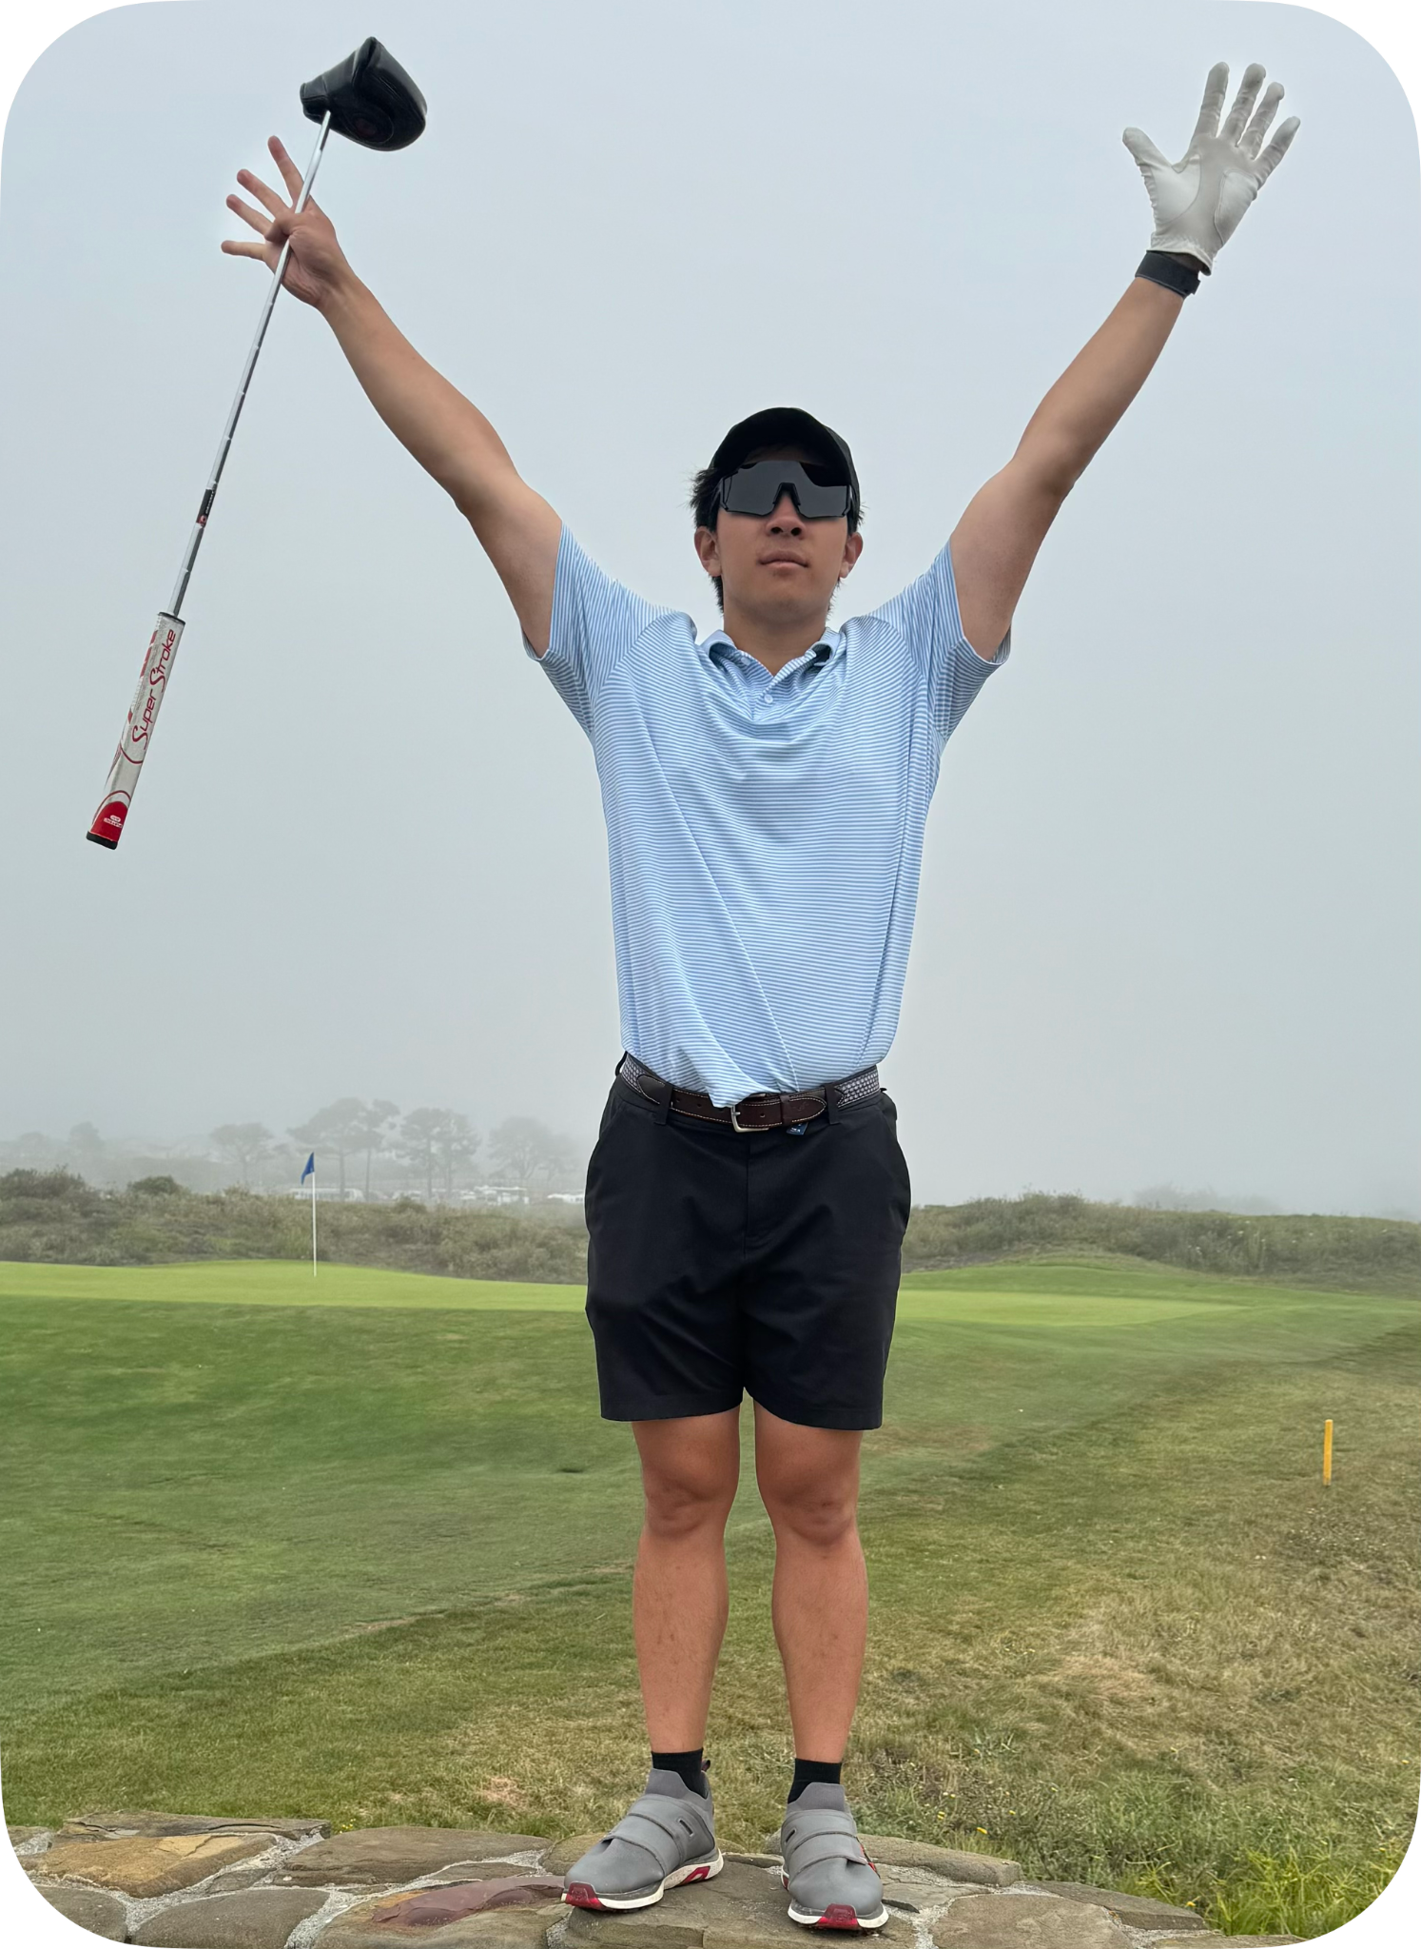


Team Intro
Taralyn
Maroua
Nick
Varsha
Class of 2026
Computer Science,
Human Computer Interaction
Class of 2024 (2025?)
Mechanical Engineering,
Product Realization
Class of 2026
Computer Science,
Human Computer
Interaction
Class of 2026
Computer Science,
Human Computer
Interaction

Slide 3
Level Up
Value Proposition
Build Human Skills One Experience at a Time

Slide 4
Level Up
Problem
Solution
Young people often struggle to develop essential human skills needed for career growth, leading to stress and a lack of direction in the career search process, as these skills are not usually taught in a traditional classroom setting.
Our solution breaks down the challenge of building human skills into manageable, engaging tasks. Through daily experiences, users steadily "Level Up," developing essential career enhancing skills and tracking their progress over time.

Slide 5
Outline of Tasks
Simple
Moderate
Complex
Wants to access a new task
Wants to track personal progress over time
Wants to compete with friends

Slide 6
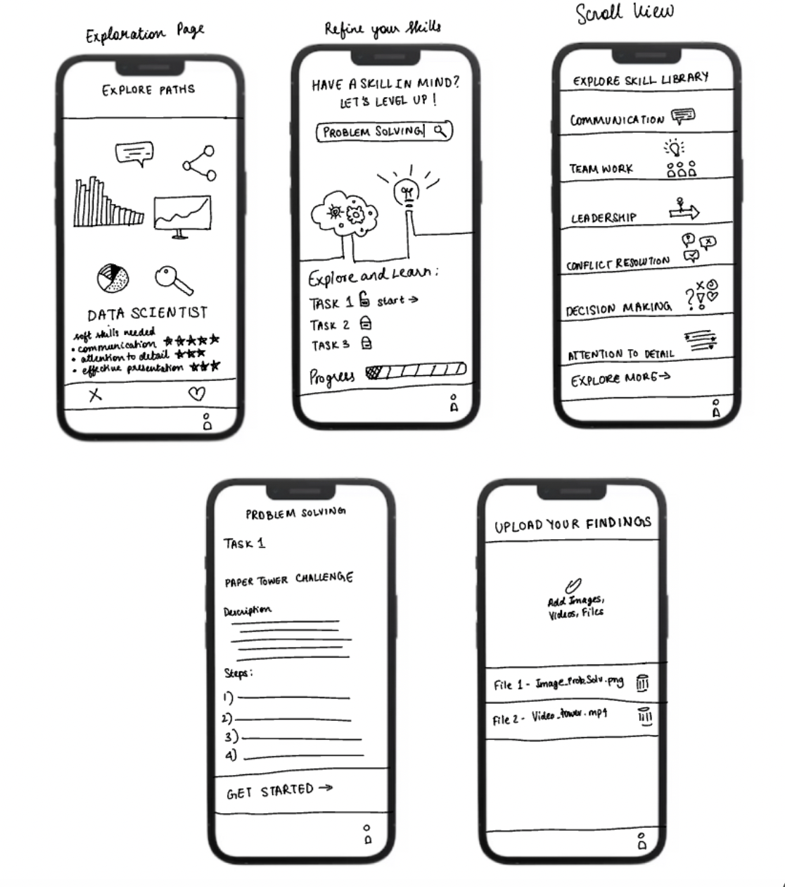
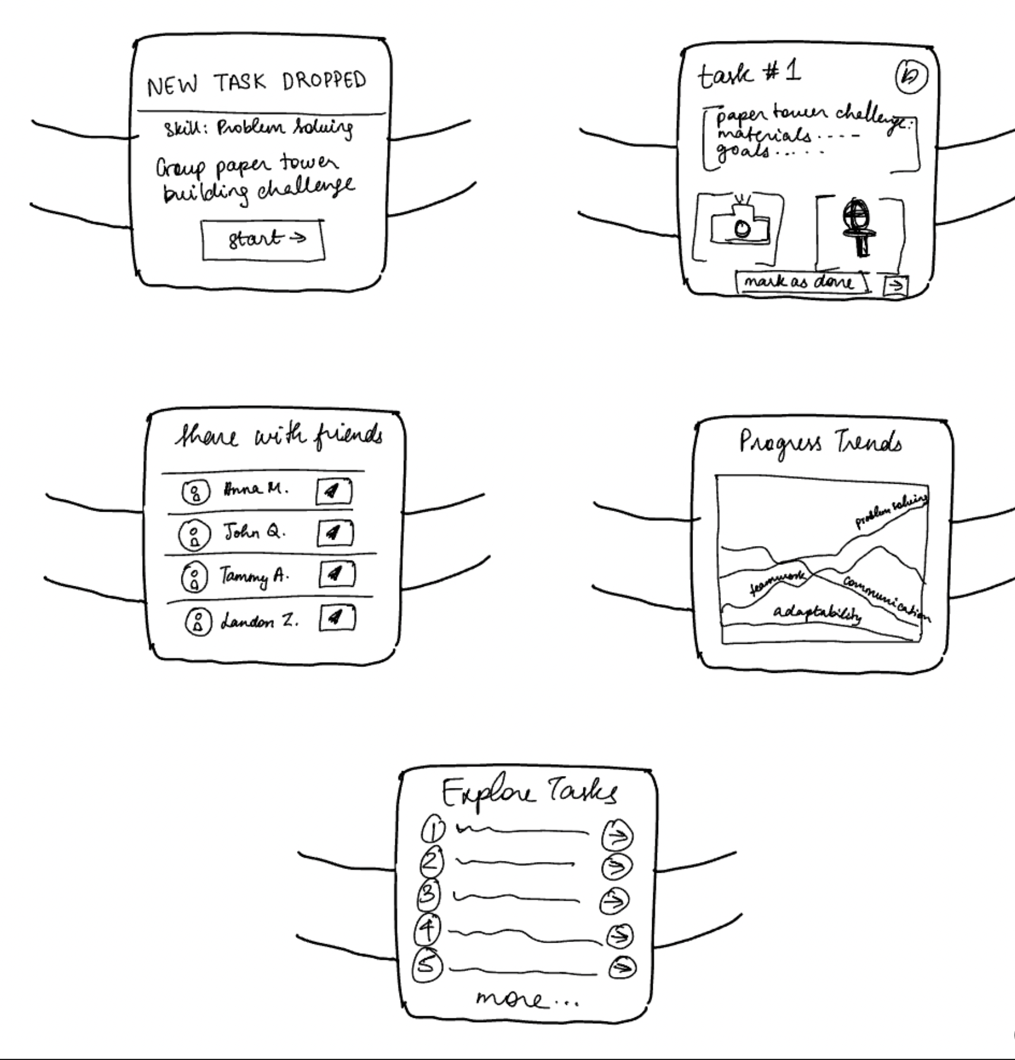
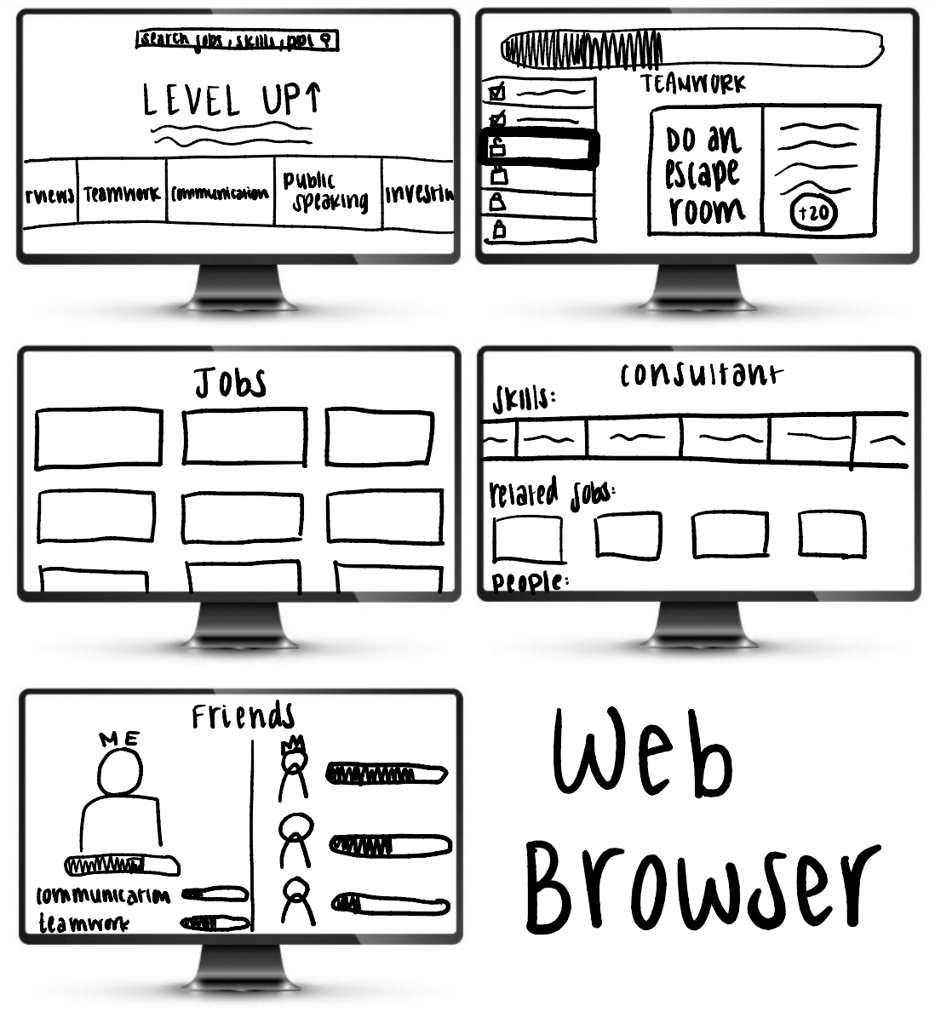
Sketching Modalities
Mobile App
Apple Watch
Web App

Slide 7
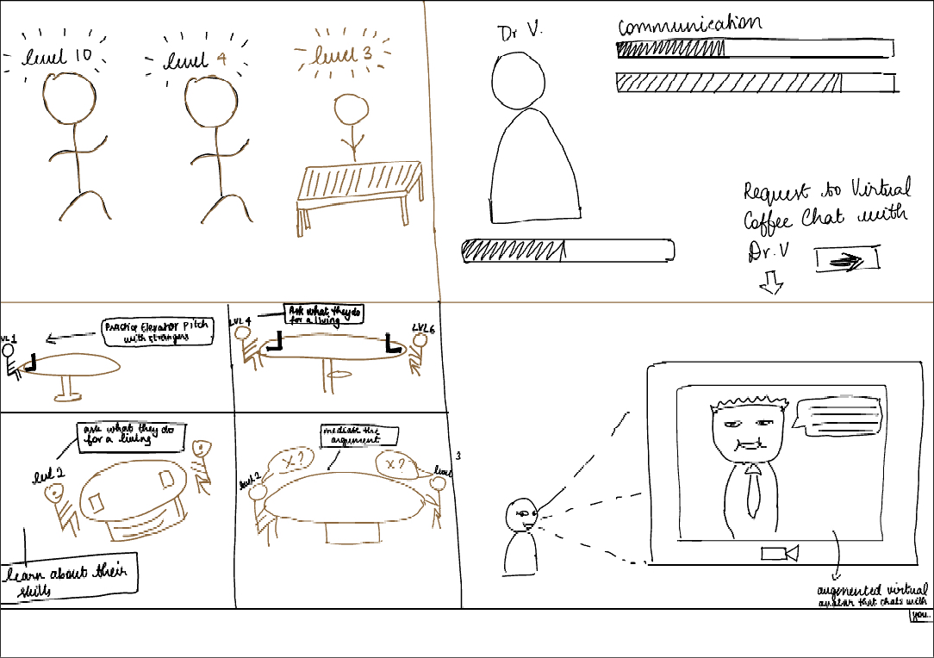
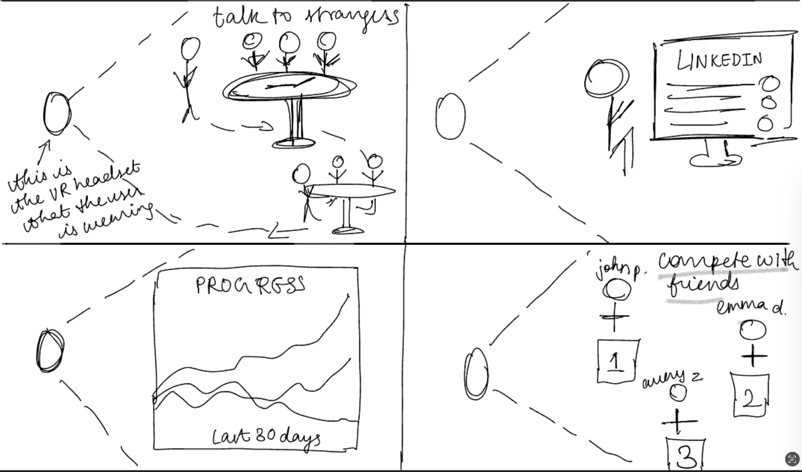
Sketching Modalities
*Brown outline represents real object/people and black represented augmented visuals
Augmented Reality
Virtual Reality

Slide 8
Top 2 Realizations + Key Screens
Mobile App
Augmented Reality

Slide 9
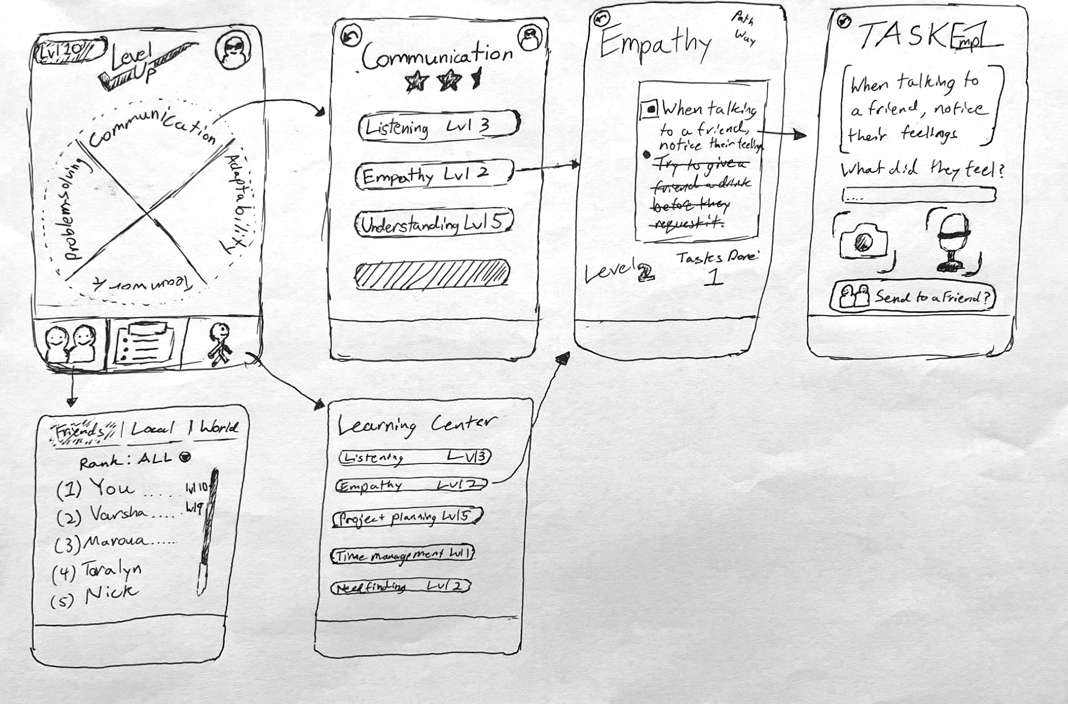
Realization #1: Mobile App

Slide 10
Realization #1: Mobile App
Pros
Cons
Mobile dimensions highlight essential features without overloading users, making it visually accessible and clear.
Aligns with the heavy mobile usage of students and early career professionals, signalling higher accessibility and adoption.
Supports notifications and reminders, which increases user engagement and encourages task completion in real-time.
Format may feel overused or less engaging due to overcrowded app market, risking our app getting lost in sea of other apps.
Potential disconnect between accessing tasks and performing them which may lead to decreased engagement and task completion.
Users with older devices or limited storage may experience performance issues, reducing accessibility and adoption.

Slide 11
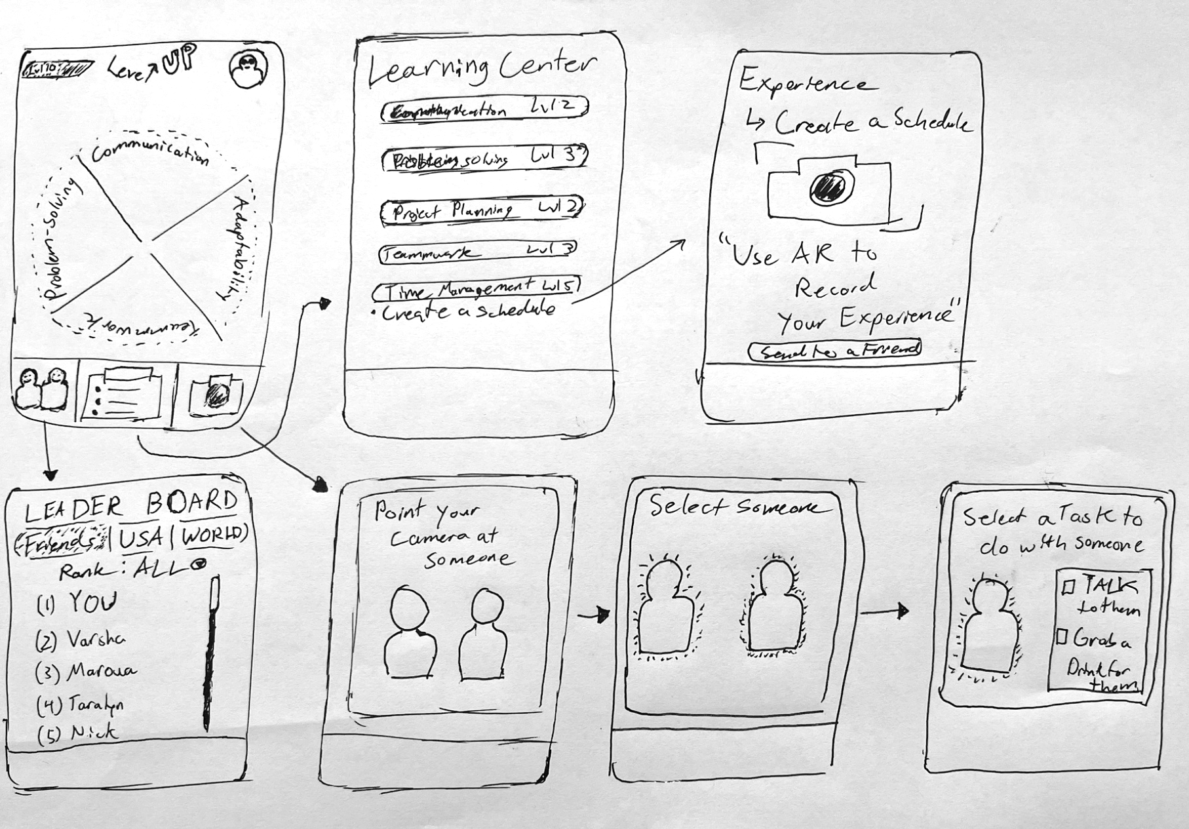
Realization #2: Augmented Reality

Slide 12
Realization #2: Augmented Reality
Pros
Cons
AR enhances accessibility by allowing users to interact with scenarios they might not otherwise experience.
The inbuilt visual engagement bridges the gap between interaction and task completion, making the experience immersive and boosting engagement.
Real-time feedback supports active participation, supporting our "learning through experience" approach and adding a "cool" factor that resonates with users.
This format requires users to point their device constantly, which may feel inconvenient or unnatural.
AR’s unfamiliarity might lead to skepticism, making some users hesitant to try it.
The format can be confusing, as what users see through the screen isn’t visible to others, potentially causing misunderstandings.

Slide 13
Selected Interface & Rationale

Slide 14
Mobile App
We want users to interact with Level Up in their daily lives to motivate them to build their human skills
We want users to seamlessly integrate Level Up into their daily routines, using hands-on experiences to build human skills without being distracted by the medium’s complexity.
The mobile app modality ensures easy access to all features—completing tasks, sharing with friends, and tracking progress—making skill-building more intuitive and engaging.

Slide 15
LoFi Prototype &
Testing Methodology

Slide 16
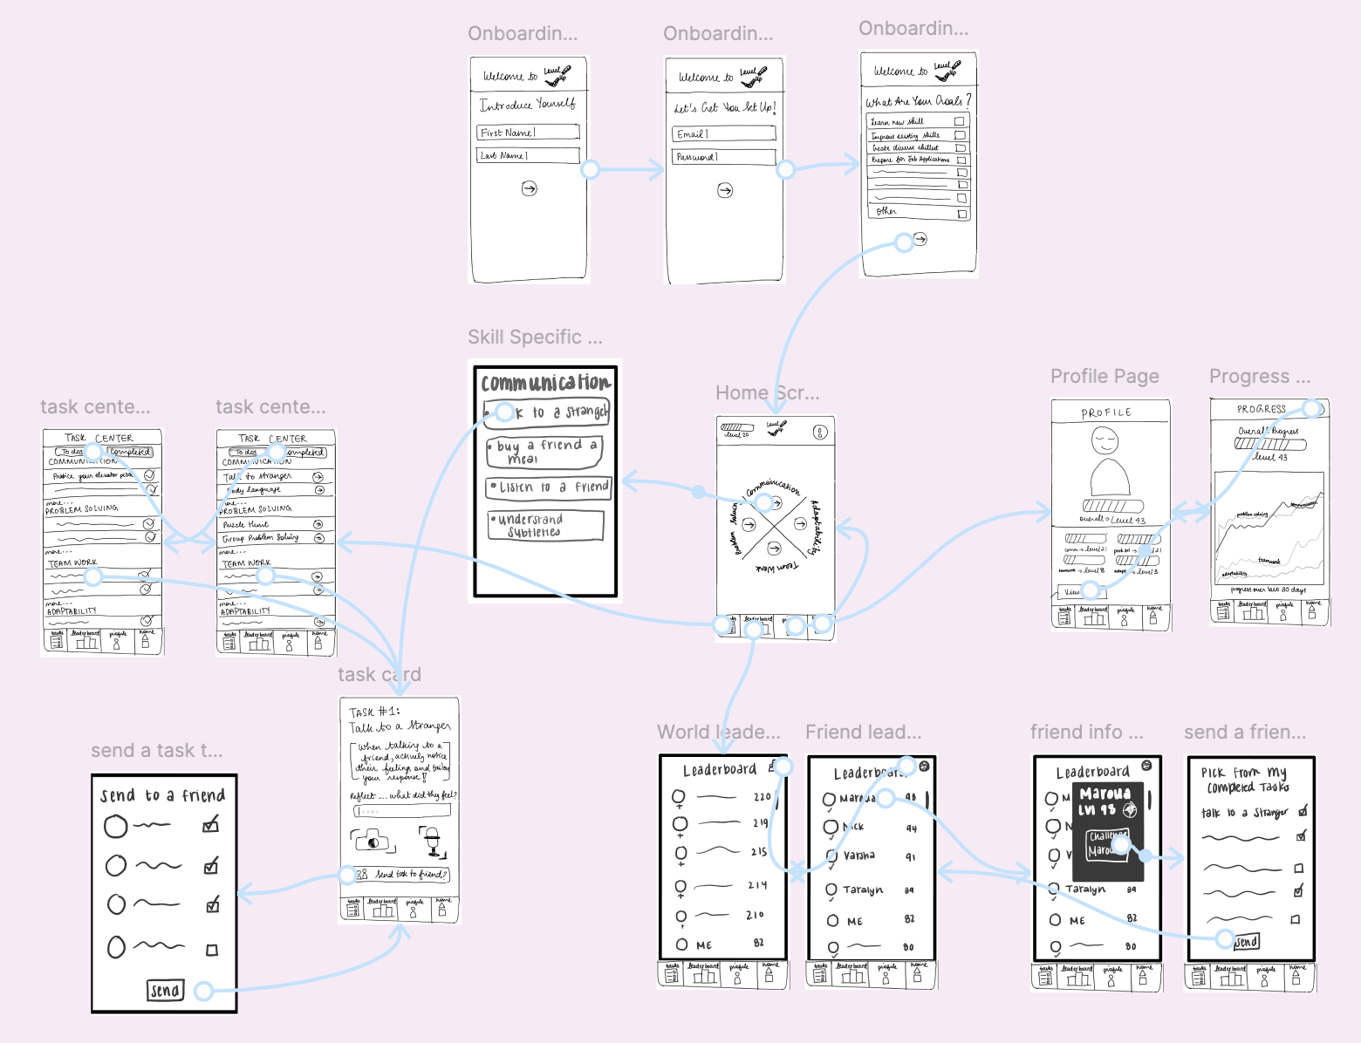
Prototype Construction / Overview

Slide 17
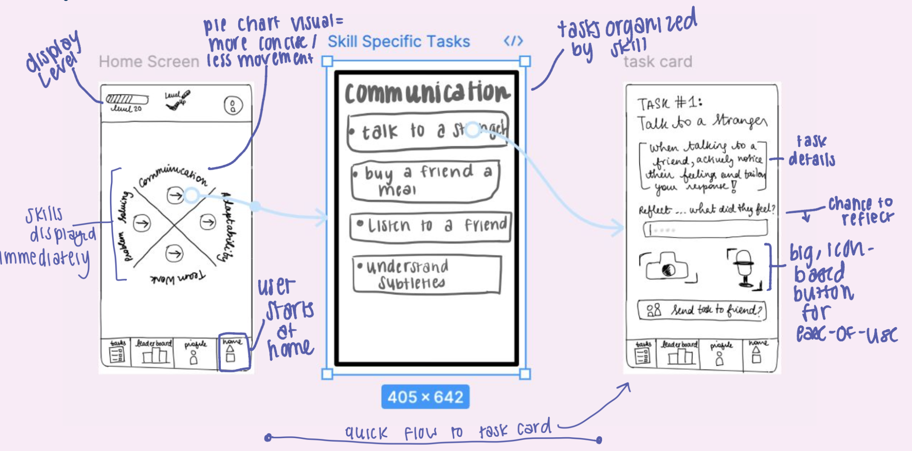
Simple Task Flow: access a new task

Slide 18
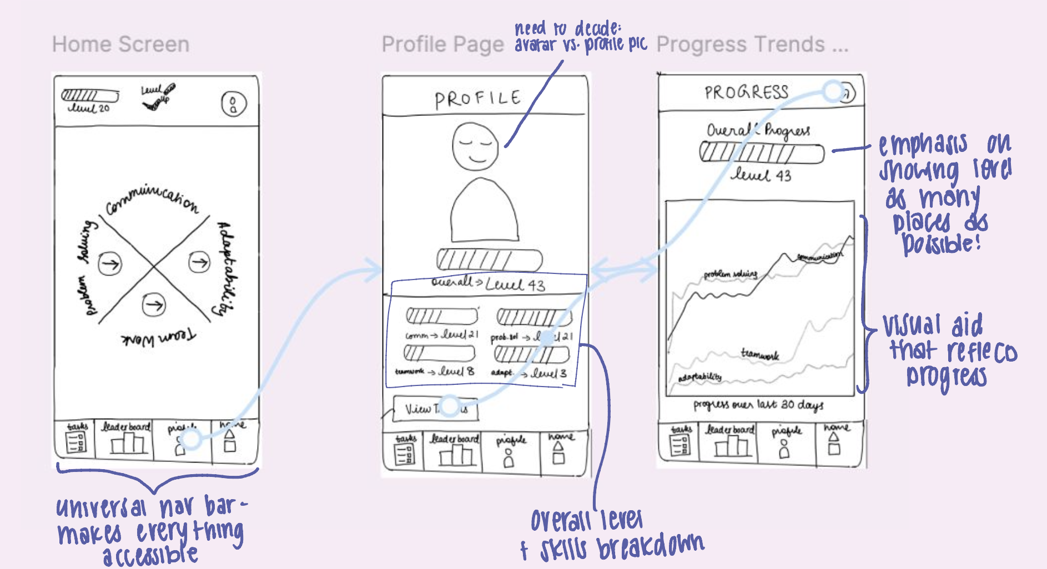
Moderate Task Flow: track personal progress

Slide 19
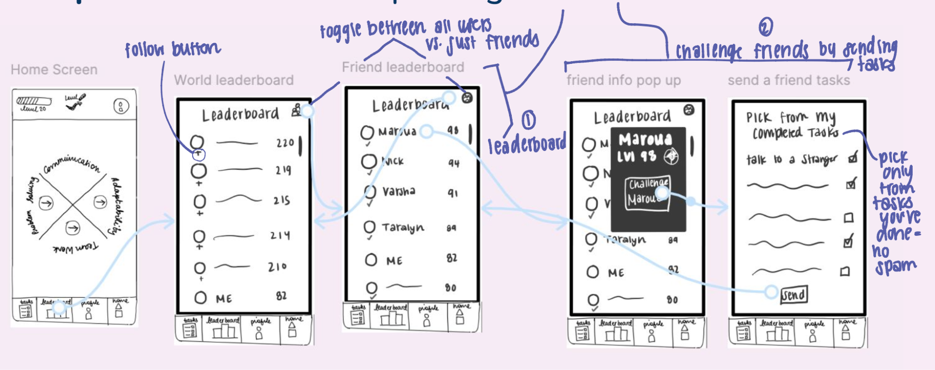
Complex Task Flow: compete against friends

Slide 20





Participants
Ashley
Taryn
Sarah
Yumna
Paarth

Slide 21
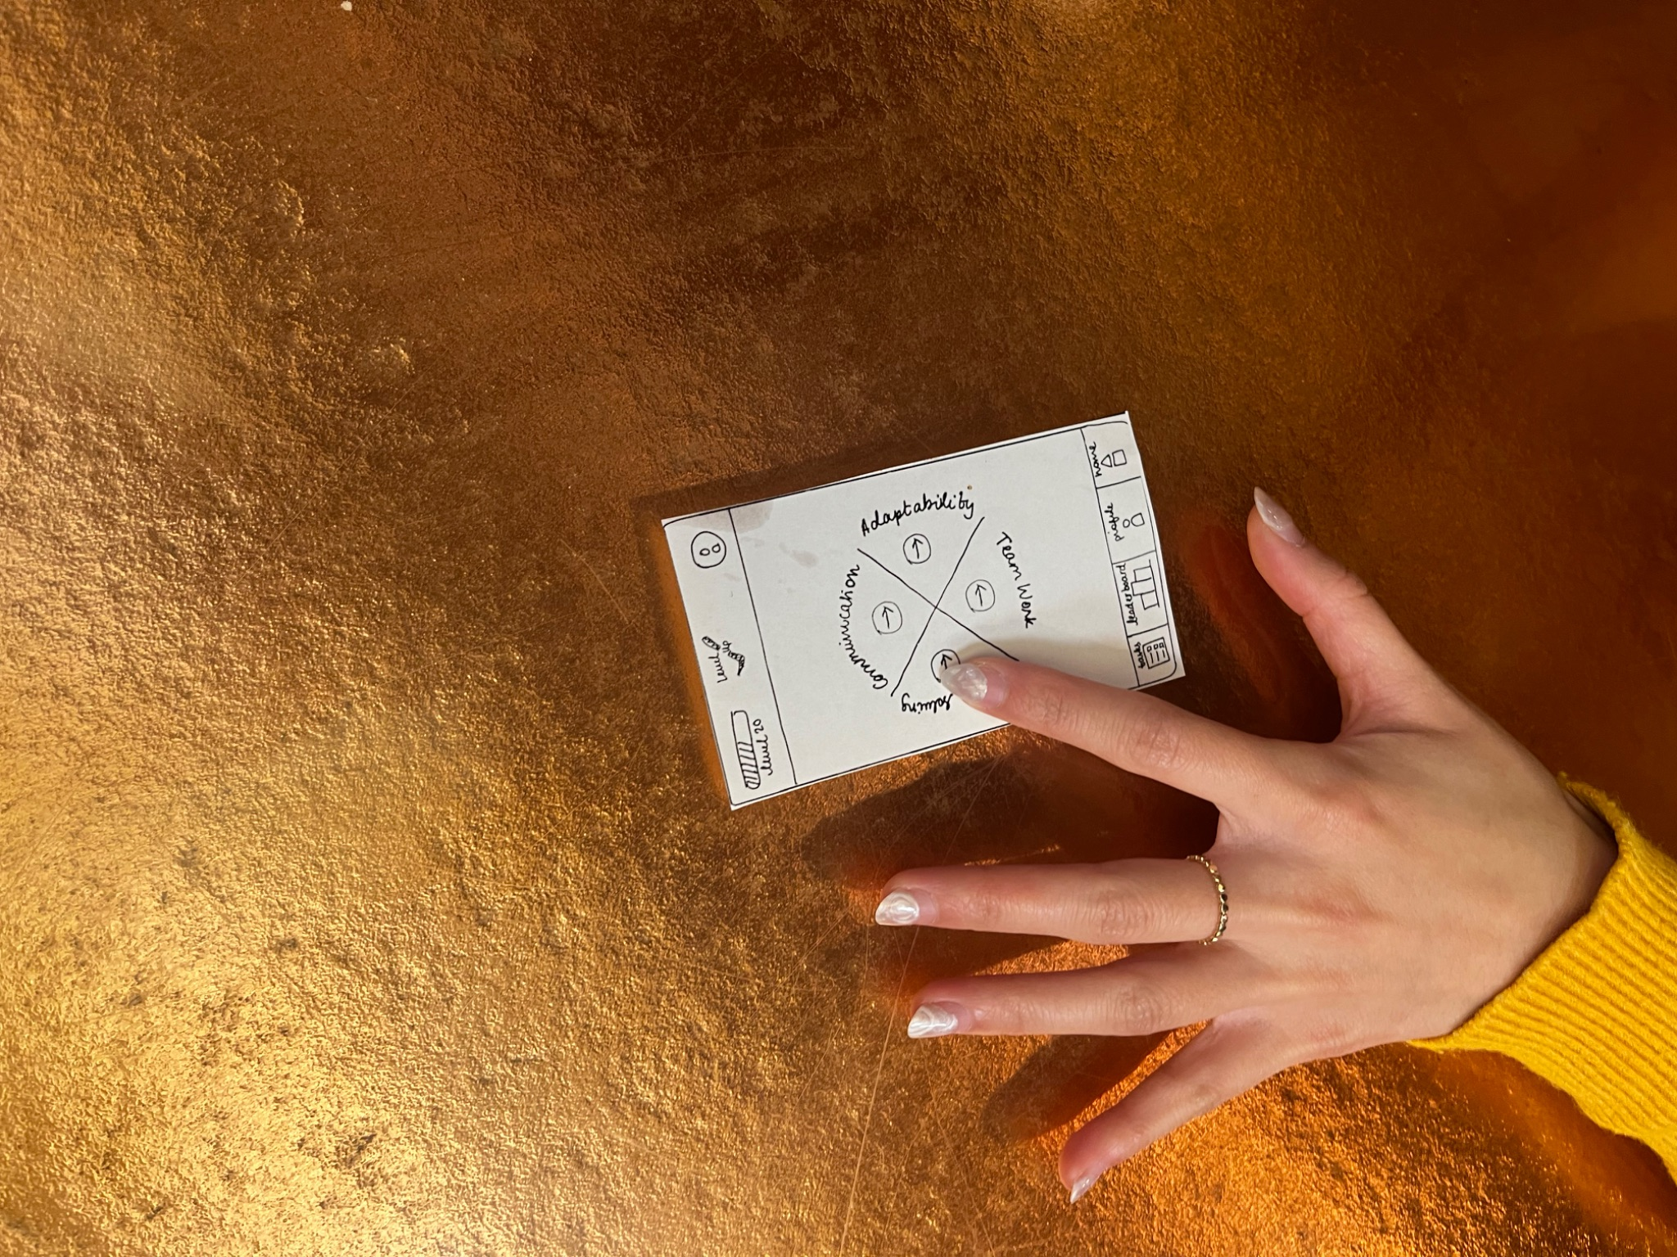
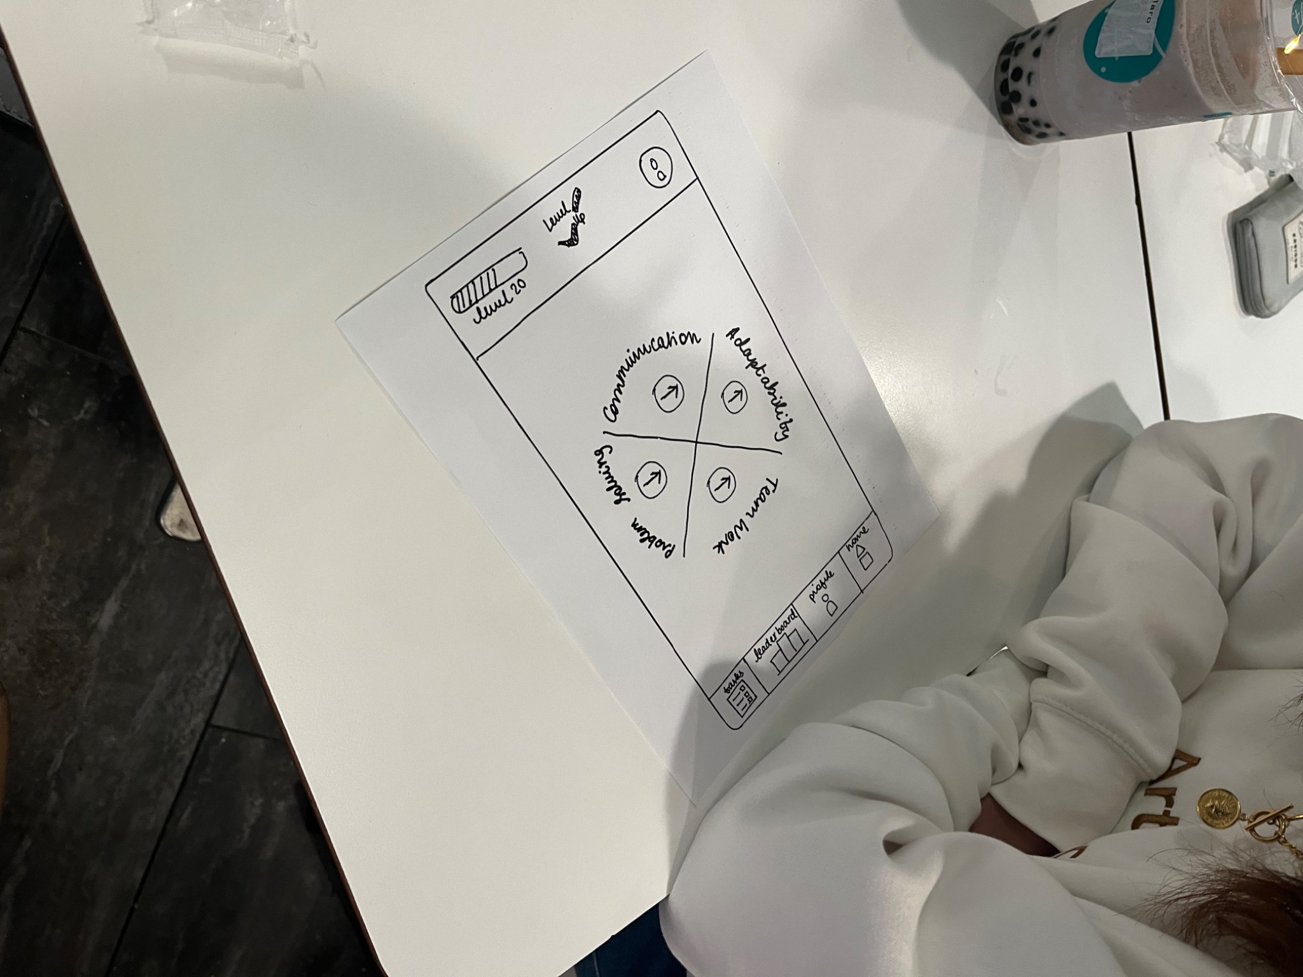
Environment and Procedure
We drove to University Ave in Palo Alto and set up our prototype in Pizza my Heart, T4, and Salt n’ Straw
We recruited our participants by walking up to them and asking for 5-10 minutes of their time
We explained the app concept and who we were
We did not compensate them

Slide 22
Our Roles
Initiator
Narrator/Computer
Timer
Notetaker
Notes:
We switched around for each Initiator - person who went and gathered participants, introduced the team and app concept
Notetaker - Took down notes, general feelings, and quotes from the participants
Timer - Timed exact times it took for the participants to complete certain tasks
Narrator/Computer - Person who led the participants through the app and gave them the tasks

Slide 23
Usability Goals Key Measurements
Testing Overview
Efficiency
One goal is to lower the barrier and efforts needed to complete tasks and build skills
Navigating our app should be easy and efficient
Enjoyment
The novelty of our tasks and the concept as a whole is that it is “bite-sized”, easy, and fun.
If users must enjoy the time spent on the app, they will be motivated them to do more tasks and use the app more
Time it takes user to get through a full task flow
Simple
Moderate
Complex
Post-test ratings (1-10)
Overall flow of app
Interface and aesthetic
Overall enjoyment of this experience and the app’s concept

Slide 24
User 1: Ashley @ T4
Measurements Comments & Insights
Results
Timing
Simple: 17s
Medium: 30s
Complex: 19s
Post-Test Ratings
Flow: 8/10
UI: 8/10
Overall Enjoyment: 6/10
Noticed the send a friend button on the task description screen while doing the simple task
Very quick with each task
Did not know you could send multiple tasks to a friend through the leaderboard
“I am pretty tech-savvy so I think older people would struggle to use this properly.”

Slide 25
User 2: Taryn @ T4
Measurements Comments & Insights
Results
Timing
Simple: 25s
Medium: 31s
Complex: 15s
Post-Test Ratings
Flow: 7/10
UI: 6/10
Overall Enjoyment: 7/10
Likes the dashboard, very easy to get to home
Home screen was confusing, did not know if the buttons did anything
Main appeal is the leaderboard, does not see much reason to use this app otherwise
“Woah that’s surprisingly a lot of words”

Slide 26
User 3: Sarah @ Pizza my Heart
Measurements Comments & Insights
Results
Timing
Simple: 4m 22s
Medium: 16s
Complex: 56s
Post-Test Ratings
Flow: 7/10
UI: 10/10
Overall Enjoyment: 7/10
“I want to get a sense of the navigation bar first and foremost”
Was confused on the task list and didn’t know she had to click into a specific task to access the card
“I’m not really sure what I would type in the reflection bar, or if I would use the camera and mic”
Never figured out how to access the friends leaderboard

Slide 27
User 4: Yumna @ Salt n’ Straw
Measurements Comments & Insights
Results
Timing
Simple: 1m 29s
Medium: 1m 28s
Complex: 8s
Post-Test Ratings
Flow: 9/10
UI: 4/10
Overall Enjoyment: 6/10
“Looking at this task list is very overwhelming… it makes me want to close the app” *proceeds to leave this screen*
On task card, doesn’t know what to add a photo of
“I like how I’m level 43… it feels rewarding!”
Took awhile for her to find metrics screen even though button was right there
Never figured out how to access friend leaderboard

Slide 28
User 5: Paarth @ Pizza my Heart
Measurements Comments & Insights
Results
Timing
Simple: 51s
Medium: 21s
Complex: 31s
Post-Test Ratings
Flow: 8/10
UI: 10/10
Overall Enjoyment: 9/10
Studied the home screen for awhile, and took him a long time to finally click on communication
Was VERY excited to see the subtleties task on the list
Did not engage with camera or recording after “doing” task
Found personal metrics button very easily
Never figures out how to access friend leaderboard

Slide 29
Implications & Design Changes
Key Findings
Implications
Design Changes
Key Finding #1:
Home Screen was confusing and did not have a clear purpose
Most users did not click the main buttons to go to the tasks screen.
Implication #1:
Home Screen needs to catch the user’s attention/be intuitive
Design Change #1:
Make Home Screen intuitively interactive and fun
We will emphasize the buttons on the home screen and make them feel satisfying to click.
Key Finding #2:
Task List was overwhelming at first sight
Some users said that they would get stressed and shut down the app. It feels like a chore.
Implication #2:
Task list is not encouraging users to build human skills
Tasks were not pleasantly presented, there were too many at once.
Design Change #2:
Clean task list and incorporate a daily challenge into the task list
Give the user the freedom to explore the app and choose tasks while guiding them in the right direction by presenting one “challenge.”
Key Finding #3:
Sending a task to a friend from the leaderboard was not touched
Every participant sent a task to a friend through the option on the task description screen.
Implication #3:
Sending a task from the leaderboard is unintuitive and completely disconnected
Design Change #3:
Leaderboard and Friends List need to be separate entities
We will focus the users to send tasks to their friends through their friend lists.

Slide 30
Next Steps
Testing Told Us:
Implement at least Three Design Changes
Make Home Screen more intuitively interactive and fun
Clean task list and incorporate a daily challenge into the task list
Leaderboard and Friends List need to be separate entities
Testing Did Not Tell Us:
The dynamics of a user going and doing a task and reporting it back to the app.
User Retention - we are unsure if the users come back and complete multiple tasks over time
How a user would navigate through the complexities of real interactions.
If users were actually motivated to do tasks and build their human skills.
We will look for disconnects in features and functions that should be easily accessible.
Take a “even my grandma could do this” approach.

Slide 31
Appendix

Slide 32
Link to Notes (Sketches, Lo-fi, Testing & More)

